Slide 1

Barstool Sports
A Twitter Sentiment Analysis

Slide 2

The Abstract
This report will offer an inside look into Barstool Sports and Stoolie culture by analyzing Tweet sentiment and assigning Sentiment Scores to each tweet.
The findings of this report can be used to guide company direction, influence online content, and observe sentiment change over time.
The purpose of this report is not to make predictions about Stoolies but rather to observe how Stoolies think, react, and tweet about Barstool Sports.

Slide 3
The Basics – 296MB of Tweets Collected
Collection Period
Number of tweets collected
Number of Users sampled
2 Weeks
266,910
189,219

Slide 4
Tools
Cloudera and Hadoop HiveSQL were used to analyze tweets for this project
A smaller subset of data was analyzed using AWS to compare the two services

Slide 5

Background – Barstool Sports
Founded in 2006
Digital Sports Media
Core audience of young adult males
Over 2 Million Twitter followers
Including over 300 Barstool Brand college accounts

Slide 6
Controversy
What makes Barstool Sports and interesting topic is their involvement in multiple national controversies.
“Barstool Sports and the persistence of traditional masculinity in sports culture”
“Inside Barstool Sports’ Culture of Online Hate”
“NFL pulls credentials from Barstool Sports”

Slide 7
Hypothesis
Positive overall Sentiment due to die-hard stoolies
Barstool Pizza Reviews will be negative due to users standing up for their local pizza place
Negative High Follower sentiment as Barstool attracts negative content from popular figures

Slide 8
Important Data Fields
create_date
user_screen_name
quoted_user_name
retweeted_user_name
tweet_text
user_location
user_followers

Slide 9
Data Error
During the data collection process, the was an unexpected error. The cause of this error is unknown. This error results in loss of Monday of collection data to be unusable due to internal JSON errors. Overall, an estimate of 10% of data was lost due to these unknown errors.
However, the project and report was still able to be completed with the data that was uncorrupted.

Slide 10



Findings
Three categories of analysis
Timetable
Users
Sentiment

Slide 11
Timetable data
Category 1

Slide 12
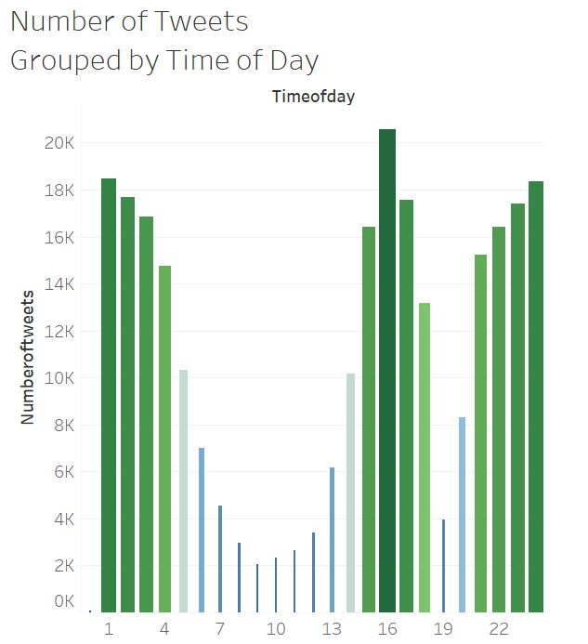
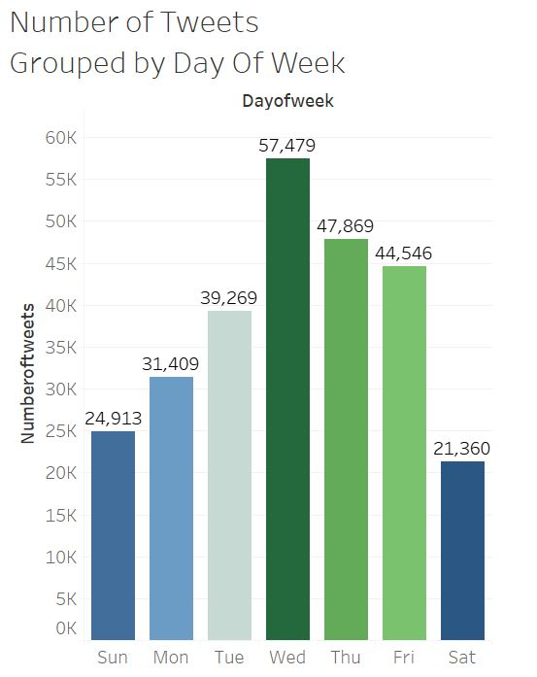
Timetable data
What time of day creates the most tweets
What days create the most tweets

Slide 13
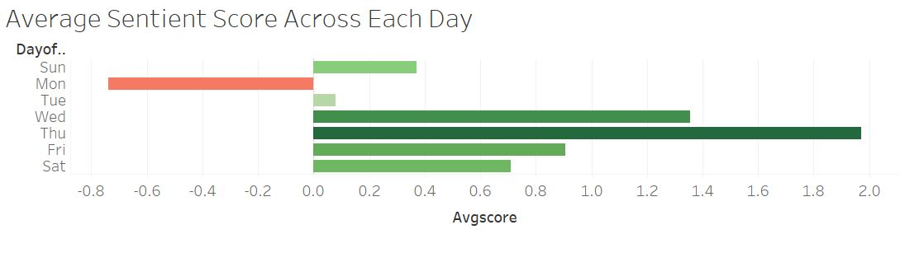
What is the average sentiment for each day of the week?

Slide 14
User data
Category 2

Slide 15
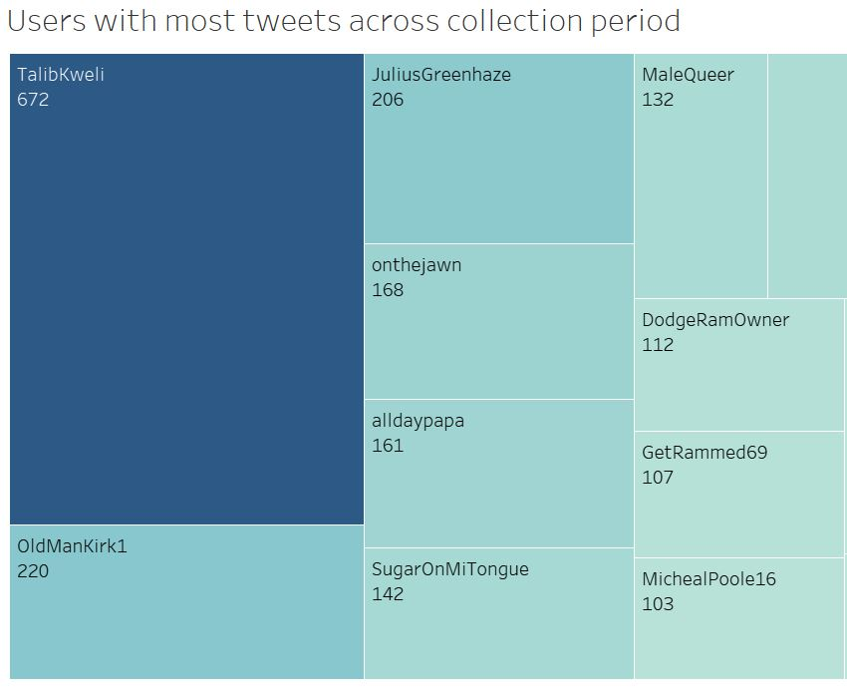
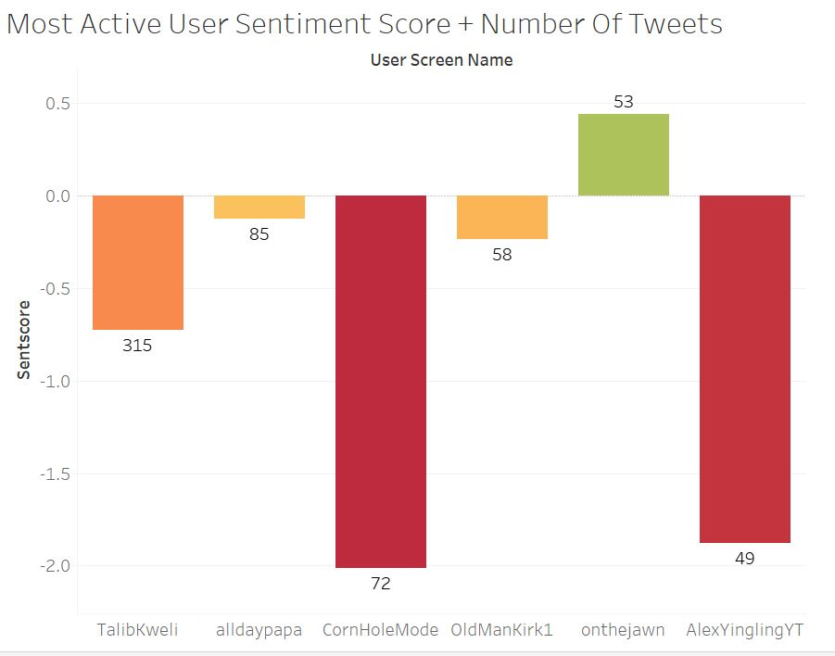
User Data
What users tweeted the most over the collection period?
Sentiment of Most Active Users

Slide 16
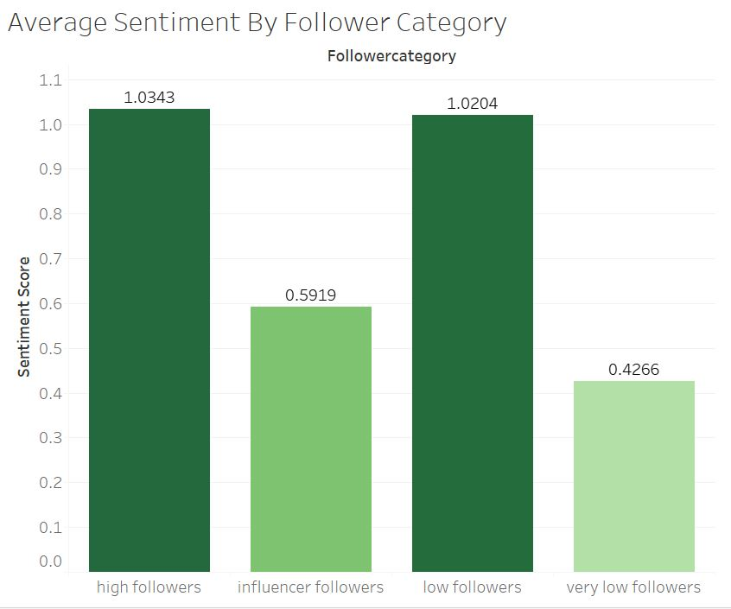
What is the average sentiment of Users with high followers?

Slide 17
Sentiment Data
Category 3

Slide 18
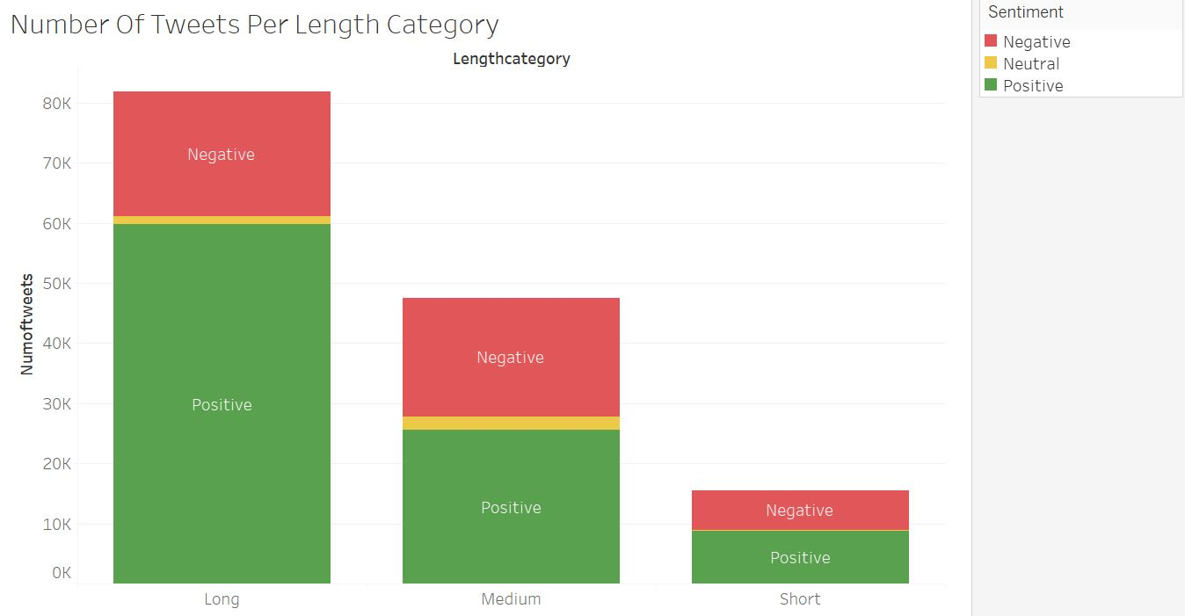
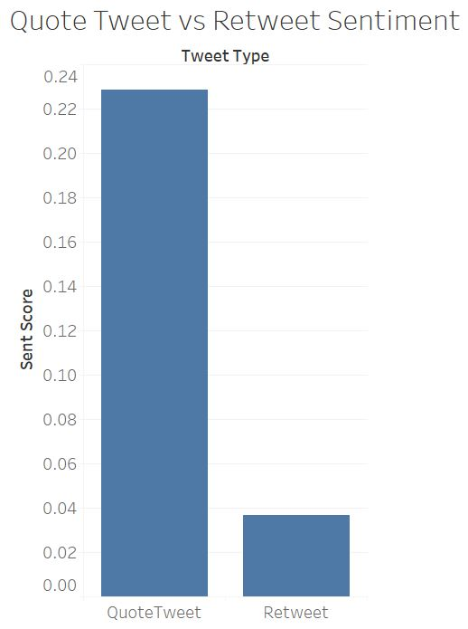
Sentiment Data
Do longer tweets have higher sentiment?
Do retweets or quote tweets have higher sentiment?

Slide 19
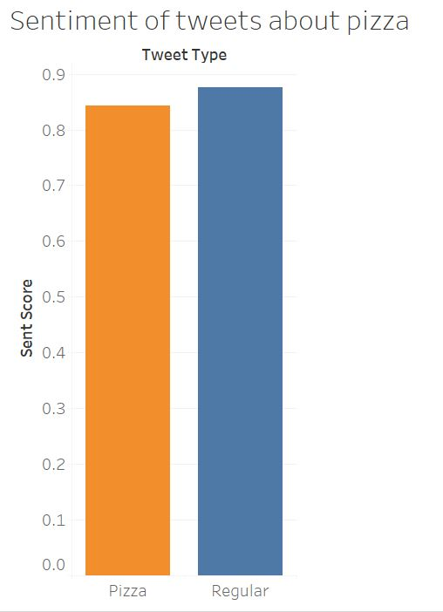
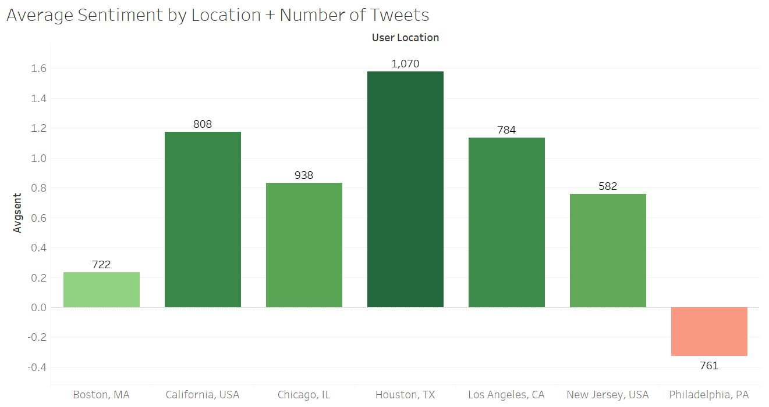
Do tweets about pizza have higher or lower sentiment?
Which locations offer the highest sentiment?

Slide 20
Amazon Web Services

Slide 21
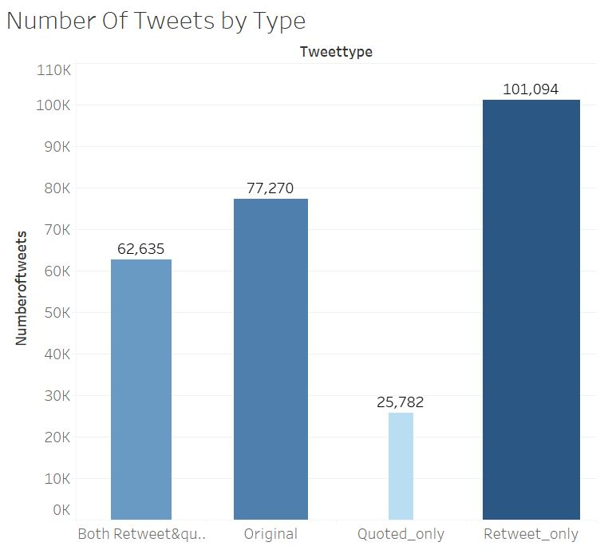
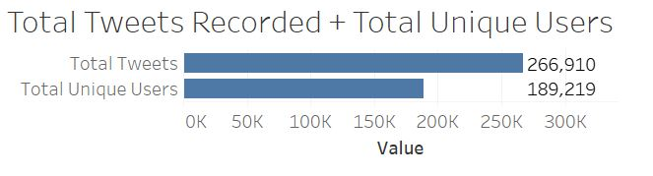
Amazon Web Services
Along with using Hadoop and Hive SQL, Amazon web services was also utilized to analyze a small subset of this data. A portion of this analysis is listed below.

Slide 22
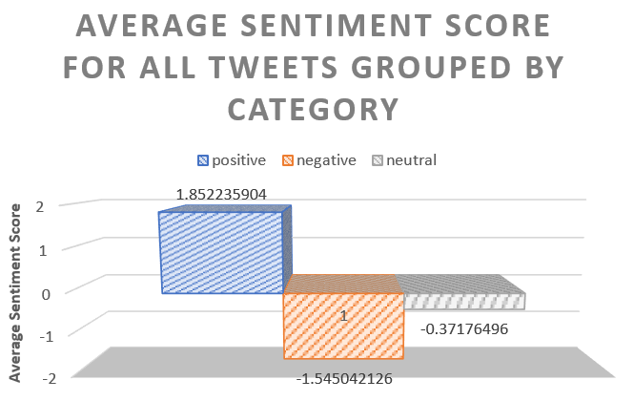
AWS (continued)

Slide 23
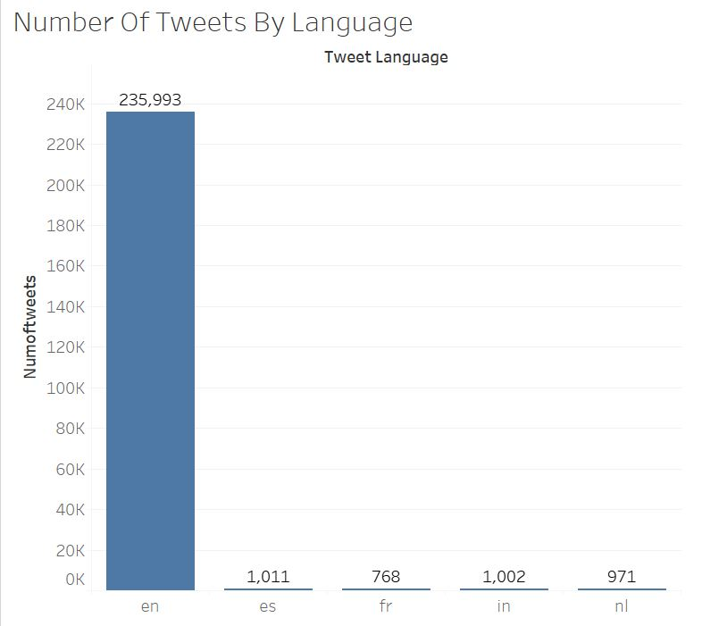
AWS (continued)

Slide 24
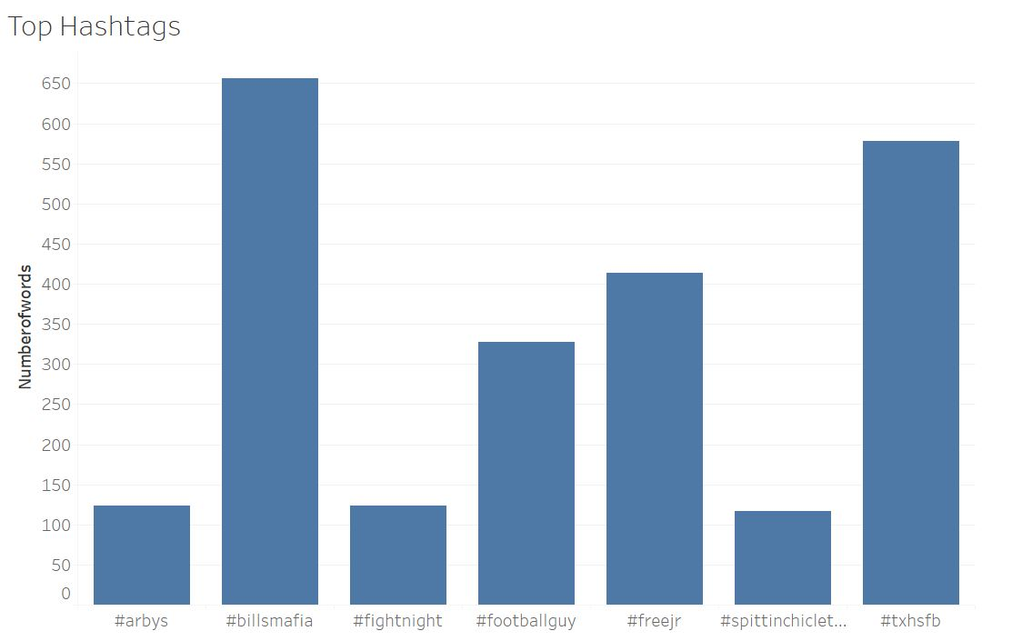
AWS (continued)

Slide 25
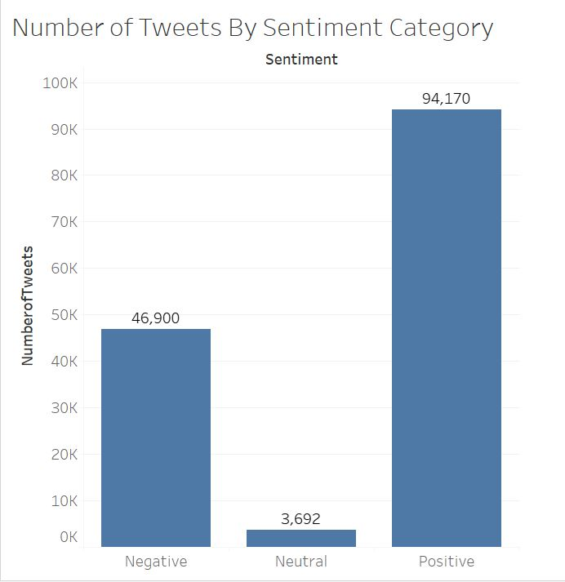
AWS (continued)

Slide 26
What does this mean FOR BARSTOOL Sports?

Slide 27
Implications and uses for this data
Company
Guide company direction
Content
Outline popular areas for content generation
Chronicle
Maintain records of customer/user sentiment over time

Slide 28
Concluding Note
Overall, this project allowed me the opportunity to explore interesting and business critical data while also learning and experimenting with new collection methods (Python tweet streaming through Jupyter Notebooks and Twitter Developer), data querying methods (Amazon Web Services, and Hive SQL/Cloudera), along with different visualization methods (Tableau and Excel).
This experience has strengthened my skills in these fields, and I am looking forwards to further exploration and development in these skills.

Slide 29
References
AWS. (2015). AWS Glossary. Retrieved December 12, 2019, from https://docs.aws.amazon.com /general/latest/gr/glos-chap.html.
Barstool Sports. (n.d.). Barstool Sports (@barstoolsports) | Twitter. Retrieved December 8, 2019, from https://twitter.com/barstoolsports?ref_src=twsrc%5Egoogle%7Ctwcamp%5Eserp%7Ctwgr
Burns, M. (2017, July 18). Past, Present, Future: How Barstool Sports Is Swinging For The Fences In Digital Media. Retrieved December 8, 2019, from https://www.forbes.com/sites/markjburns/2017/07/11/past-present-future-how-barstool-sports-is-swinging-for-the-fences-in-digital-media/#1dc98f554edb
DailyBeast. (n.d.). Barstool and Sexual Harassment. Retrieved December 8, 2019, from https://www.thedailybeast.com/inside-barstool-sports-culture-of-online-hate-they-treat-sexual-harassment-and-cyberbullying-as-a-game
Hootsuite. (2019, October 31). 25 Twitter Statistics All Marketers Should Know in 2020. Retrieved December 8, 2019, from https://blog.hootsuite.com/twitter-statistics/
NBC. (2017, January 31). NFL pulls credentials from Barstool Sports. Retrieved December 8, 2019, from https://profootballtalk.nbcsports.com/2017/01/31/nfl-pulls-credentials-from-barstool-sports/
NBC. (2019, September 21). Barstool Sports and the persistence of traditional masculinity in sports culture. Retrieved December 8, 2019, from https://www.nbcnews.com/news/us-news/barstool-sports-persistence-traditional-masculinity-sports-culture-n1057061

Slide 30
Thank you
Nicholas Curci

